Slide 1
Genetic algorithms
GA

Slide 2
Genetic Algorithms
A genetic algorithm (or short GA) is a search technique used in computing to find true or approximate solutions to optimization and search problems.
Genetic algorithms are categorized as global search heuristics.
Genetic algorithms are a particular class of evolutionary algorithms.

Slide 3
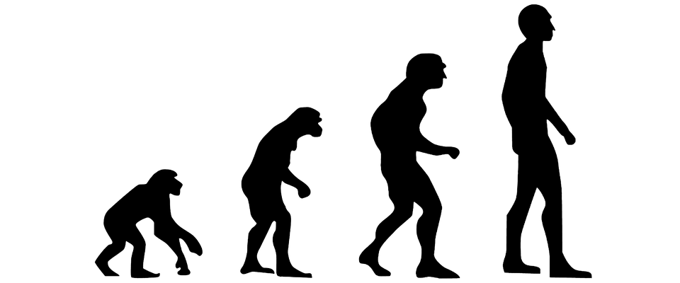
History
Based on the mechanics of biological evolution
Initially developed by John Holland, University of Michigan (1970’s)
These algorithms are now used by a majority of Fortune 500 companies to solve difficult scheduling, data fitting, trend spotting and budgeting problems, and virtually any other type of combinatorial optimization problem.

Slide 4
Biological evolution
Organisms produce a number of offspring similar to themselves but can have variations due to mutations(random changes)
Some offspring survive, and produce next generations, and some don’t:
Genetic algorithms uses this principle to find solutions.

Slide 5
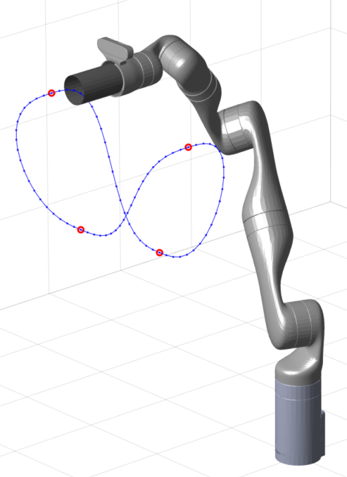

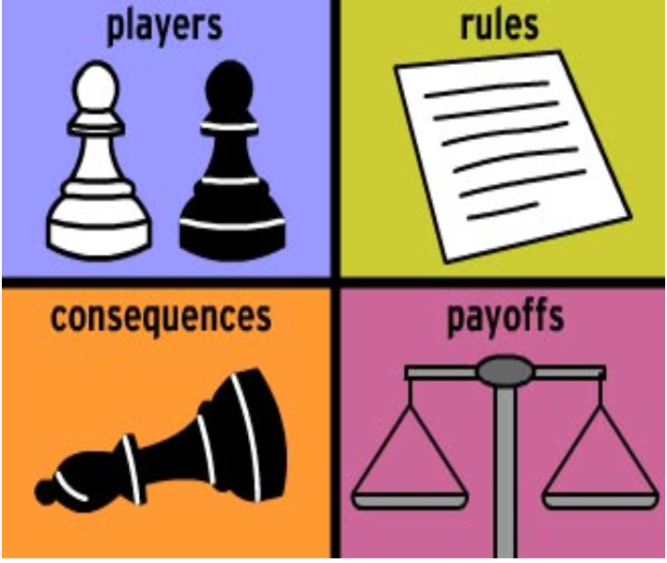
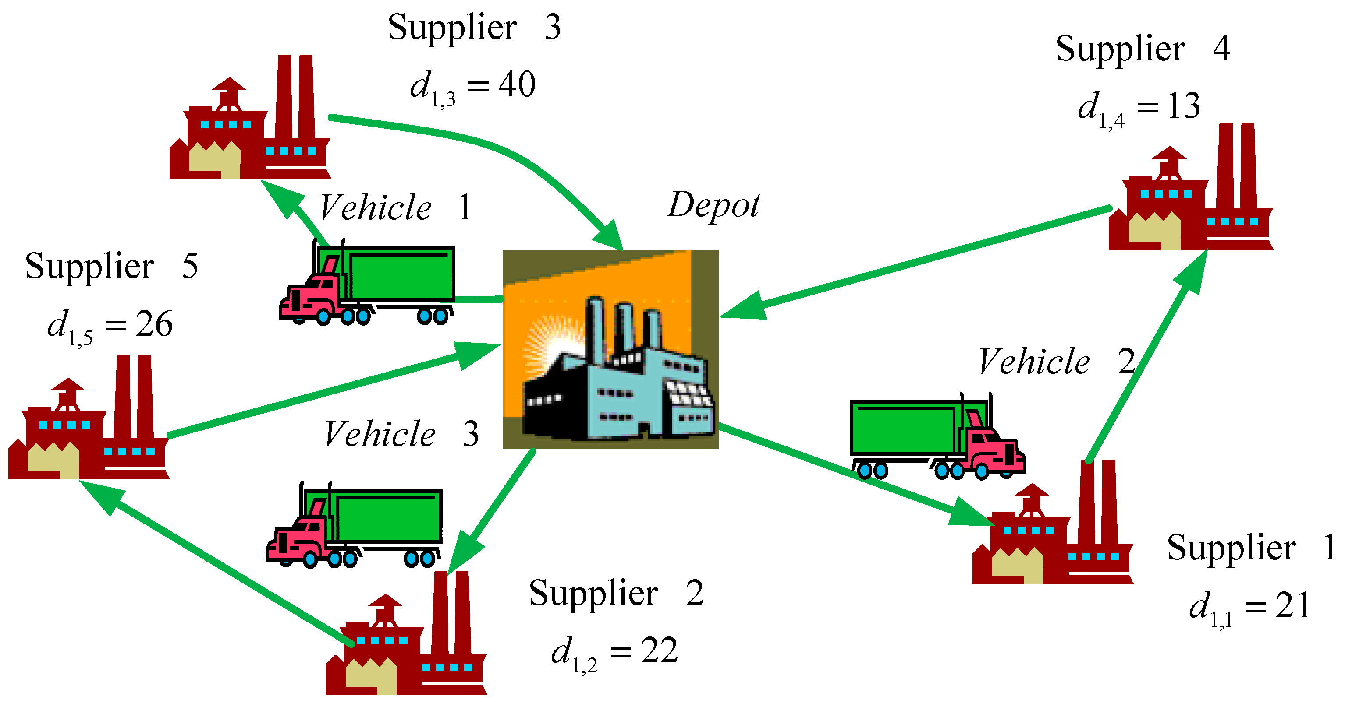
Applications
Problems which appear to be particularly appropriate for solution by genetic algorithms include timetabling and scheduling problems, and many scheduling software packages are based on GAs.
Gas have also been applied to engineering Genetic algorithms are often applied as an approach to solve global optimization problems.
As a general rule of thumb genetic algorithms might be useful in problem domains that have a complex fitness landscape as recombination is designed to move the population away from local optima that a traditional hill climbing algorithm might get stuck in.

Slide 6

Advantages
It can find fit solutions in a very less time. (fit solutions are solutions which are good according to the defined heuristic)
The random mutation guarantees to some extent that we see a wide range of solutions.
Coding them is really easy compared to other algorithms which does the same job.

Slide 7

Disadvantages
No guarantee of finding global maxima.
Time taken for convergence. You usually need a decent sized population and a lot of generations before you see good results.
It's a black art. Fine tuning all the parameters for the GA, like mutation rate, elitism percentage, crossover parameters, fitness normalisation/selection parameters, etc, is often just trial and error.

Slide 8
Basic Structure of Genetic Algorithm
POPULATION INITIALIZATION
Each iteration in the cycle produces a new “generation of chromosomes
The entire set of generations is called a run
Typical GA run is from 50 to 500 or more generations
At the end of a runn often there is at least one highly fot chromosome in the population
FITNESS ASSIGNMENT
GA OPERATORS
SELECTION
Loop until termination criteria is reached
CROSSOVER
MUTATION
SURVIVOR SELECCION
TERMNATE & RETURN BEST

Slide 9
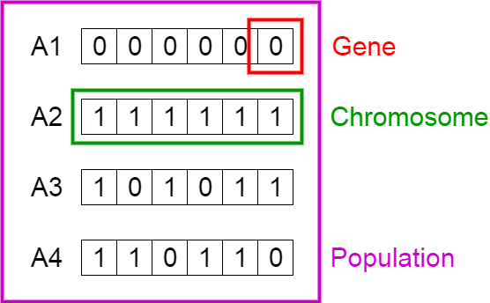
Terminology of GA
Population- subset of all the posible solutions to the given problem
Chromosomes – one such solution to given problem
Gene – one element position of a chromosome
Allele – vaue a gene takes for a particular chromosome
Genotype – population in the computation space
Phenotype – population in the actual real world solution space
Decoding – transforming a solution from the genotype to the phenotype space
Encoding – Transforming form the phenotype to the genotype space
GENOTYPE SPACE
DECODING
ENCODING
PHENOTYPE SPACE

Slide 10
Example
Consider a bag with a capacity of 15 kg. It is desired to carry the objects with the following features:
Object | 1 | 2 | 3 | 4 | 5 | 6 | 7
Profit | 10 | 5 | 15 | 7 | 6 | 18 | 3
Weight(kg) | 2 | 3 | 5 | 7 | 1 | 4 | 1

Slide 11
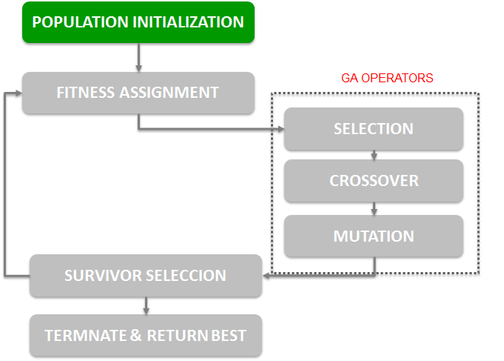
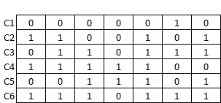
Population initialization
STEP 1 – Chromosome Encoding
Ci =
Gene: 0- Absence of the ítem in the knapsack 1- Presence of the ítem in the knapsack
Set space = 2⁷
Initial population is created and chromosomes randomly created

Slide 12
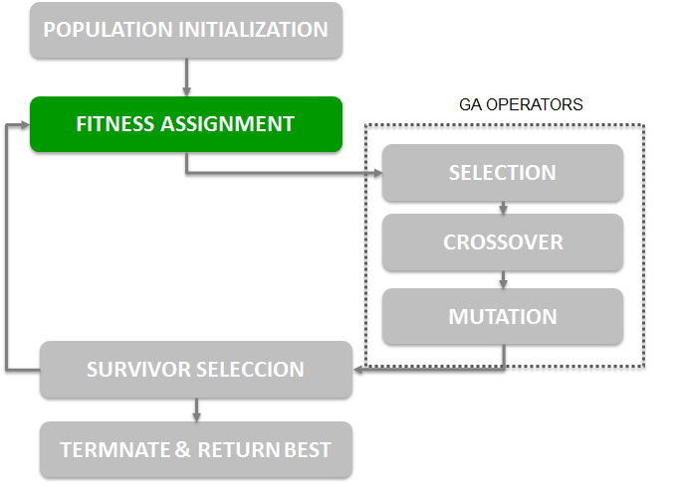
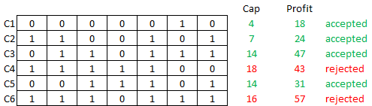
STEP 2- Fitness function
Determine fitness function which is used to evaluate how good a particular solution is.

Slide 13
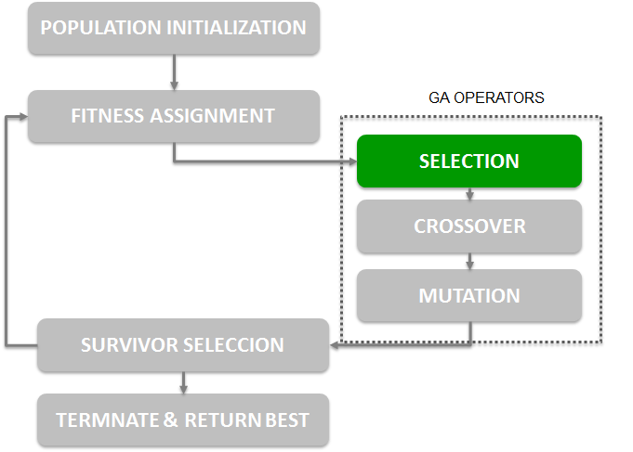
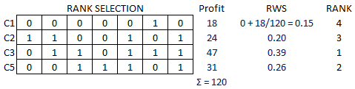
STEP 3: Selection
Collect the filter individual and wake up the next generation, chromosome using Roulette Wheel Selection(RWS)
GENERATION 2
C3
C5
C2
C1

Slide 14
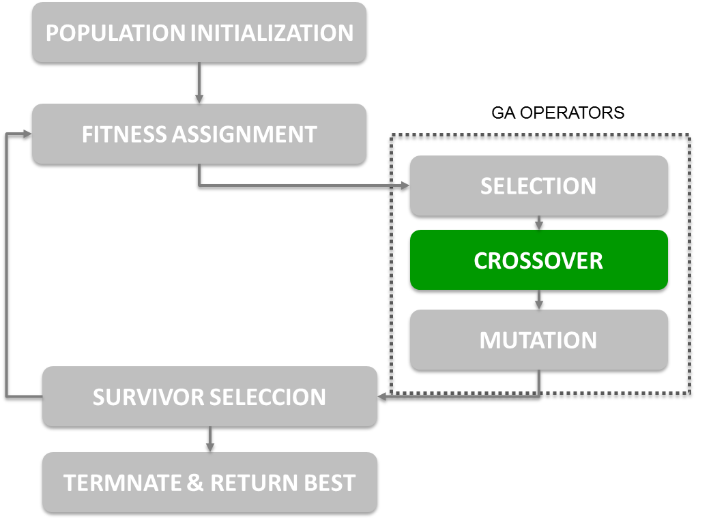
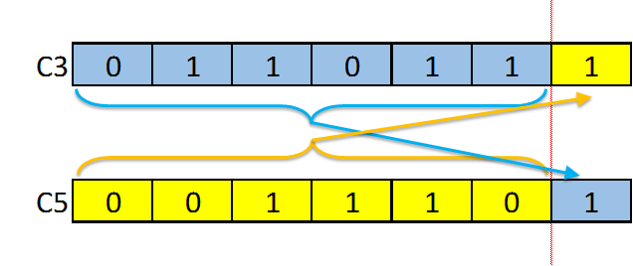
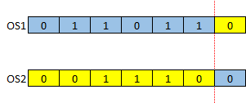
STEP 4 Crossover
One point crossover – Ramdomly select the position on the chromosomes about which gene would be Exchange
Result of the one point crossover --- produced offspring

Slide 15
Crossover…
GENERATION 2
C3
C5
C2
C1
OS1 will replace C3
OS2 will replace C5
C3 and C5 would be replaced by their offspring
C2 and C1 did not go for the crossover so they will remain in the next generation
GENERATION 3
OS1
OS2
C2
C1

Slide 16
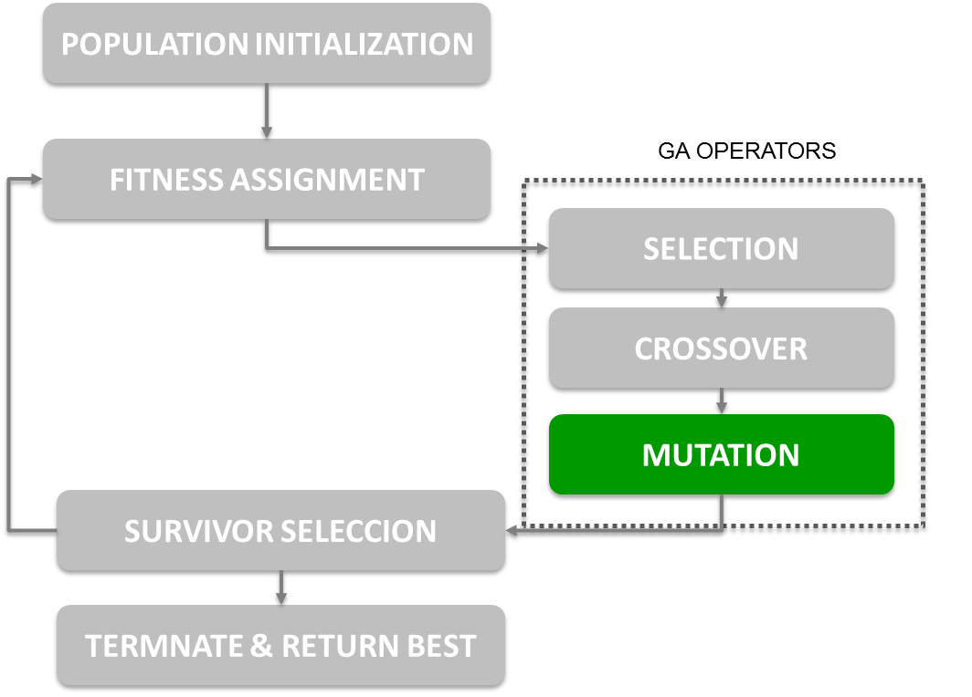
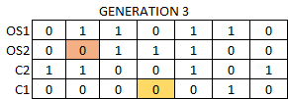

Mutation
Is the process by which a string is deliberately changed so as mantain diversity in the population set
Mutation probability – determines how often the parts of a chromosome will be mutated

